Slide 1
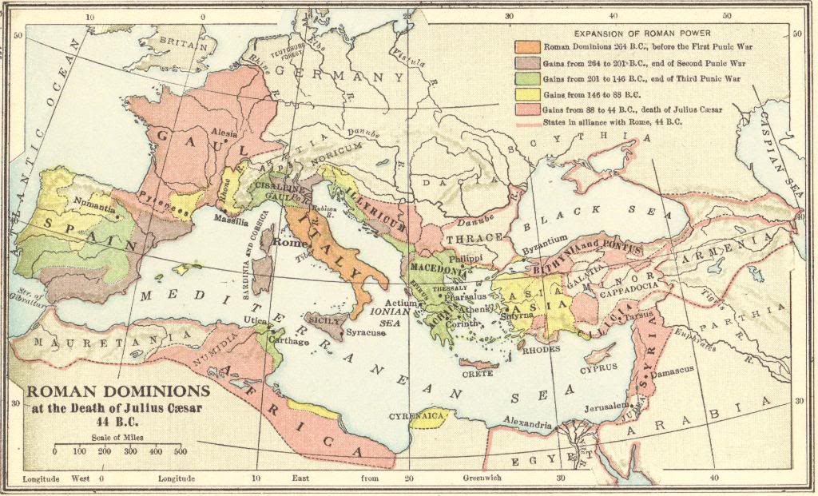
Civil War in Rome and the End of the Roman Republic
© Student Handouts, Inc.
www.studenthandouts.com

Slide 2
Tiberius Gracchus and Land Reform
The lower classes (plebeians) were suffering.
133 BCE – Tiberius Gracchus was elected as tribune of the plebeians
Wanted to limit the amount of land each person could own
Wanted to rebuild the farming class by redistributing land
The patricians were not pleased with Tiberius Gracchus
Tiberius Gracchus told the people: “You fight and die to give luxury to other men…but you have not a foot of ground to call your own.”
Tiberius Gracchus and hundreds of his followers were murdered
He promised land reform

Slide 3
Gaius Gracchus and Reform
Gaius was elected tribune in 122 BCE, about ten years after his brother was murdered.
He also wanted land reform.
Gaius wanted even more than land reform.
Gaius wanted the government to sell grain to the poor at reduced prices.
Gaius proposed that landless Romans be settled in the provinces.
Gaius wanted a public works program to employ the poor.
Gaius wanted to reform the way that taxes were collected by publicans in the provinces.
Gaius wanted to decrease the Senate’s power.
Riots erupted. In 121 BCE, he was killed along with thousands of his supporters.

Slide 4
Differing Parties Continued to Argue
Optimates
Senatorial party
Populares
People’s party
Had its strength in the Comitia (Assembly)
Wanted to maintain the position and power of the wealthy patrician class
Wanted reforms

Slide 5
Military Dictators Come to Power
Why did military dictators come to power?
  Constant fighting in Rome between the rich and poor
  Restlessness in the provinces
  Slave rebellions (e.g., Spartacus)
  Barbarian invasions (though not as serious as they became during the era of the Roman empire)
  The people needed strong leadership

Slide 6
Gaius Marius (ca. 157 BCE-86 BCE)
A leader of the Populares
  Elected consul in 107 BCE
Successful military victories
  North Africa (106 BCE) against a rebellious chieftain
  North Italy (102-101 BCE) against Germanic invaders
Elected consul seven times
Army reform
  Formed a paid, volunteer, professional army staffed by Rome’s landless people (no more property qualifications)
  Soldiers shared in the spoils of war and earned pensions upon completion of their service
Struggled with Lucius Sulla for power

Slide 7
Lucius Sulla (ca. 138 BCE-78 BCE)
Patrician member of the Senate
Military victories
  91 BCE – revolt of Roman allies who wanted full citizenship rights
    These people eventually won Roman citizenship, but not before Sulla had secured his reputation as a leader
  87 BCE – revolt by King Mithridates in Asia Minor
    Assembly chose Gaius Marius for the same job
    Armies fought in Rome; Sulla won and marched off to Asia Minor
Marius and his supporters came to power in Rome while Sulla was away
  Killed many leaders in the Senate
  Sulla came back to Rome in 82 BCE
  Sulla killed thousands of Marius’ followers and confiscated their property as booty for his troops
Sulla ruled as dictator for three years
  Gave the Senate back control of the government
  Then he retired

Slide 8
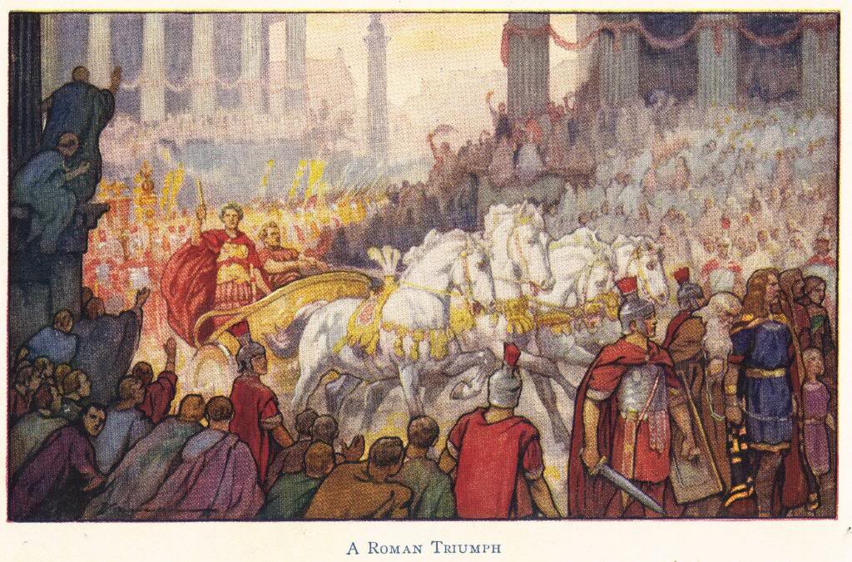

Slide 9
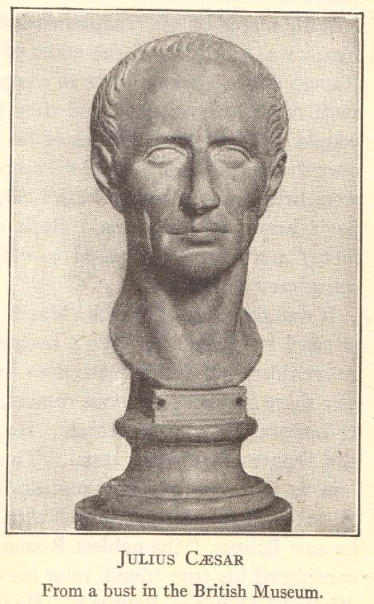
The First Triumvirate
The First Triumvirate was an unofficial (and at first secret) pact to control Rome
From 60 to 53 BCE
Members:
  Pompey
  Marcus Crassus
  Julius Caesar

Slide 10
Pompey (106 BCE-48 BCE)
A general under Sulla
Military victories
  Cleared pirates out of the Mediterranean
  Put down a revolt in Iberia (Spain)
  Finished Sulla’s fight against King Mithridates
  Conquered Palestine (Israel and Judea) and Syria for Rome
Became angry with the Senate
  Senate did not give him full recognition for his achievements
  Senate refused to pay his soldiers

Slide 11
Marcus Crassus (115 BCE-53 BCE)
General who defeated Spartacus
Became wealthy by devious means
  Abusing the proscription system
    Proscription was the legal confiscation of the property of those who had fought against those now in power
    Crassus reportedly had at least one person, whose fortune he coveted, added to the proscription list
  Bought burning buildings
    Heard a building was on fire, then ran to buy it as it was burning
    After buying it, he’d have his people put out the fire before too much damage was done
      The traditional Roman firefighting method was to destroy a burning building in order to save those structures surrounding it

Slide 12
Julius Caesar (100 BCE-44 BCE)
Elected consul in 59 BCE
Military victories
  59-51 BCE – brought the Gauls (in modern-day France) under Roman rule
    He wrote the famous Commentaries on the Gallic Wars

Slide 13
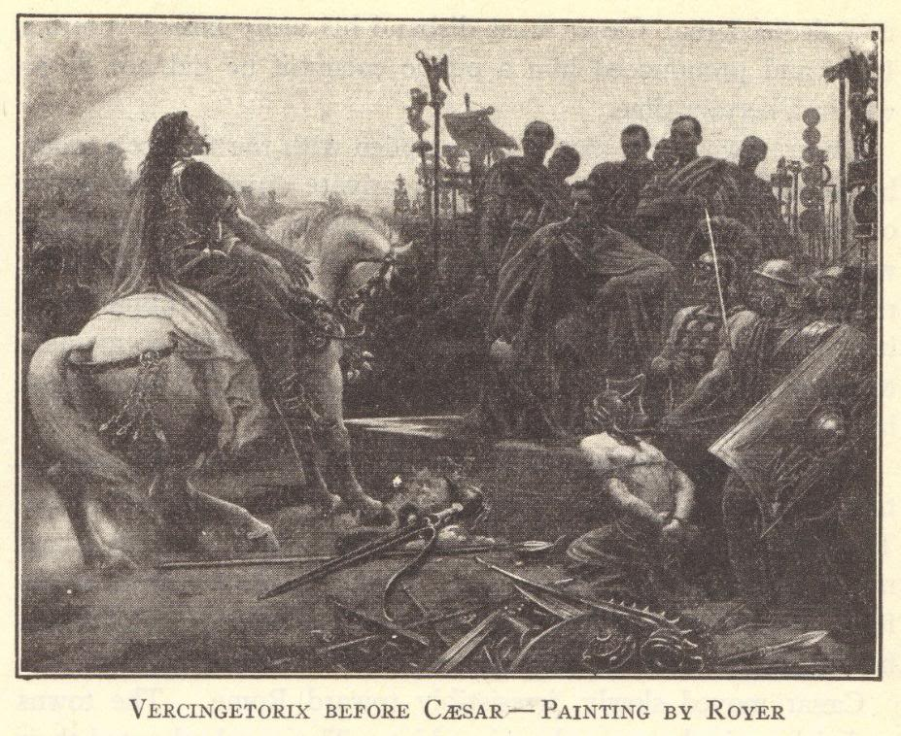

Slide 14
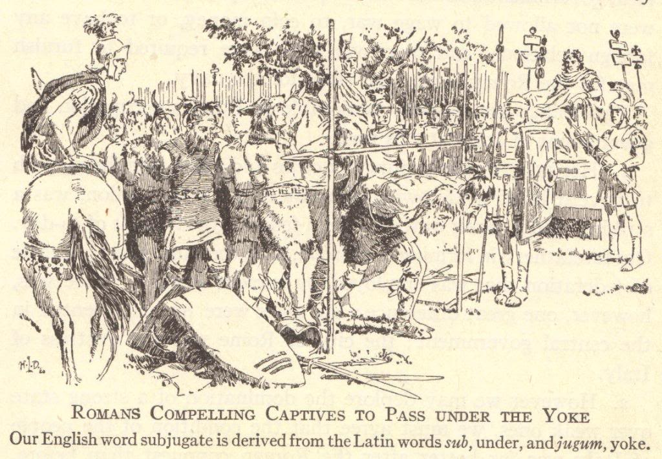

Slide 15
The First Triumvirate
Pompey
His perk: soldiers
Became leader of Italy
Marcus Crassus
His perk: money
Became leader of Rome’s Eastern provinces
Julius Caesar
His perk: popularity
Became proconsul of Gaul (modern France)

Slide 16
Trouble in Paradise
53 BCE – Crassus killed in battle against the Parthians
  This ended the First Triumvirate
Pompey was jealous of the successes Caesar was having in Gaul
  Pompey talked the Senate into demanding that Caesar return to Rome as a private citizen (without his troops)

Slide 17
Crossing the Rubicon
Caesar had a decision to make
  Following the Senate’s orders = powerlessness before Pompey
  Disobeying the Senate’s orders = Violating Roman law
Rubicon River
  River in northern Italy
  Tradition and law said that soldiers had to disband before crossing this river into Italy
“The die is cast. I have crossed the Rubicon.”
  He led his troops across the Rubicon River
  Once he crossed the river, he could not take back his decision to face (and fight) Pompey

Slide 18
Caesar Chases Pompey to Egypt
Pompey fled to Greece.
Caesar met Cleopatra VII of Egypt.
Caesar went after him, defeating Pompey at Pharsalus in 48 BCE.
Pompey fled to Egypt.
Ptolemy XIII, knowing Caesar’s army was in pursuit of Pompey, killed Pompey rather than give him shelter
Pompey, who had more soldiers, made serious military blunders.
Caesar said of Pompey: “Today the enemy would have won, if they had a commander who was a winner,” and “That man does not know how to win a war.”
Ptolemy later presented Pompey’s severed head to Caesar
She was co-ruler, married to her younger brother, Ptolemy XIII
Caesar restored Cleopatra to her throne
Also had a son with Cleopatra, Caesarion, born in 47 BCE

Slide 19
“Veni, vidi, vici!”
Caesar left and won victories in the East
  Mocked Pompey’s previous efforts in the region
  Sent word to Rome: “Veni, vidi, vici!”
    “I came, I saw, I conquered!”
Military victories left Caesar as sole ruler of Rome
  Defeated remnants of the senatorial party in north Africa
  Defeated Pompey’s sons in Spain
Caesar returned to Rome in 45 BCE
  Aided by his close friend and helper, Mark Antony

Slide 20
Caesar’s Reforms
Adopted a program of public works.
Granted Roman citizenship to many people in Rome’s provinces.
Reformed provincial governments.
Reorganized the Roman system of coinage.
Distributed public lands to Roman citizens.
Reformed the calendar (the “Julian” calendar with 365 days and an extra day during leap years).

Slide 21
Dictator for Life
The Senate disliked many of Caesar’s reforms and feared his popularity and power
Ides of March
  March 15, 44 BCE
  Senators conspired to assassinate Caesar
  Mark Antony tried to stop Caesar from entering the Senate, but a group of senators intercepted Caesar and got him to enter the building using a side entrance
  Caesar was stabbed to death (at least 23 times) on the floor of the Senate house
  Among the conspirators was Marcus Junius Brutus, a descendent of the traditional founder of the Roman Republic

Slide 23
Chaos and More Civil War
Caesar left his grandnephew Octavian as his heir
Second Triumvirate
  Octavian allied himself with Mark Antony and a politician named Lepidus
  Went after Caesar’s enemies
  42 BCE – defeated the forces of two of Caesar’s assassins, Brutus and Cassius, at Philippi, Macedonia
Split the rule of the empire
  Octavian took Rome and the West
  Mark Antony took the East

Slide 24
Octavian versus Mark Antony
Octavian was a smart, capable ruler in Rome
Mark Antony made problematic alliances and ignored Rome’s dictates for the East
  Mark Antony formed a relationship with Cleopatra VII in Egypt
  Antony and Cleopatra had three children together
  Mark Antony divorced Octavia, Octavian’s sister
  Mark Antony offended Rome by “going native”
  Mark Antony offended Octavian by publicly suggesting that Caesarion was a legal and rightful heir of Julius Caesar
32 BCE – Octavian’s forces attacked Egypt
  31 BCE – Battle of Actium – Mark Antony’s fleet was destroyed
  30 BCE – Mark Antony committed suicide
  Cleopatra committed suicide a few weeks later

Slide 25
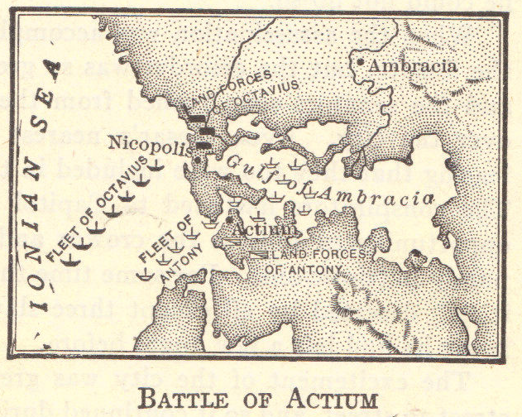

Slide 26
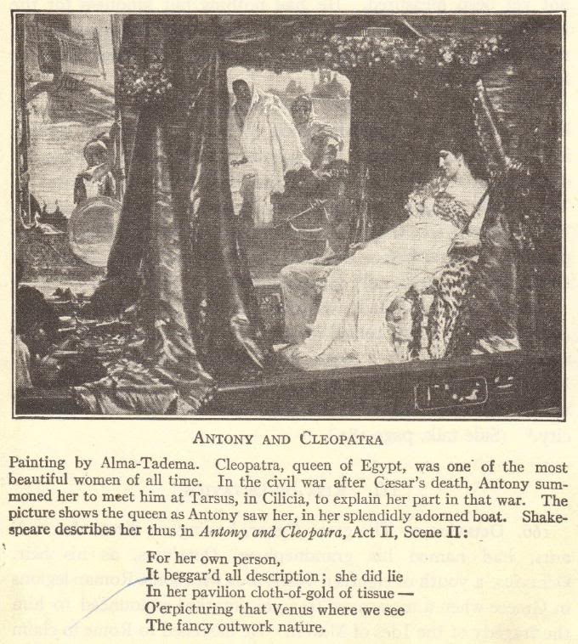

Slide 27
Review Questions
How and why were the Gracchi brothers killed?
How and why did military dictators come to power in Rome?
Who were the members of the First Triumvirate, and what did each member bring to the equation?
What steps led to Caesar being Rome’s sole ruler?
Describe Caesar’s assassination, including its causes and effects.
Explain how and why Mark Antony and Octavian came into conflict.

